Slide 1
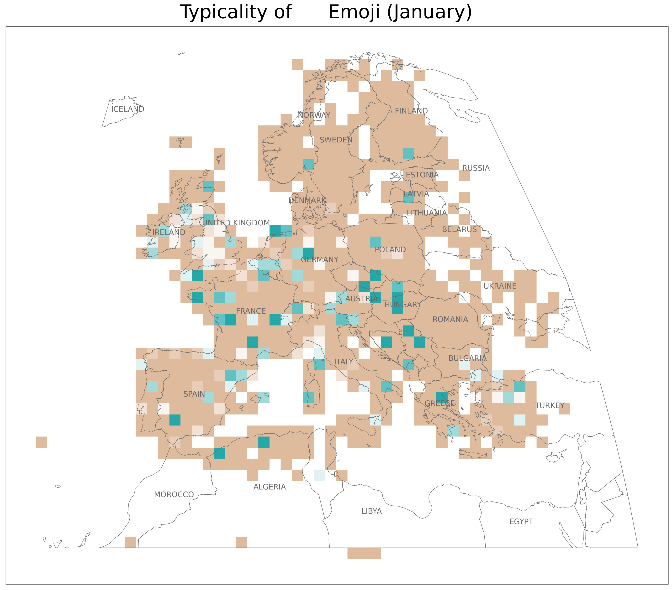

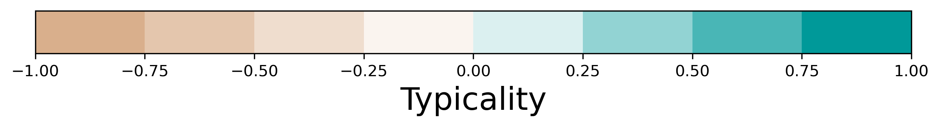
<
>

Slide 2

<
>

Slide 3

<
>

Slide 4

<
>

Slide 5

<
>

Slide 6

<
>

Slide 7

<
>

Slide 8
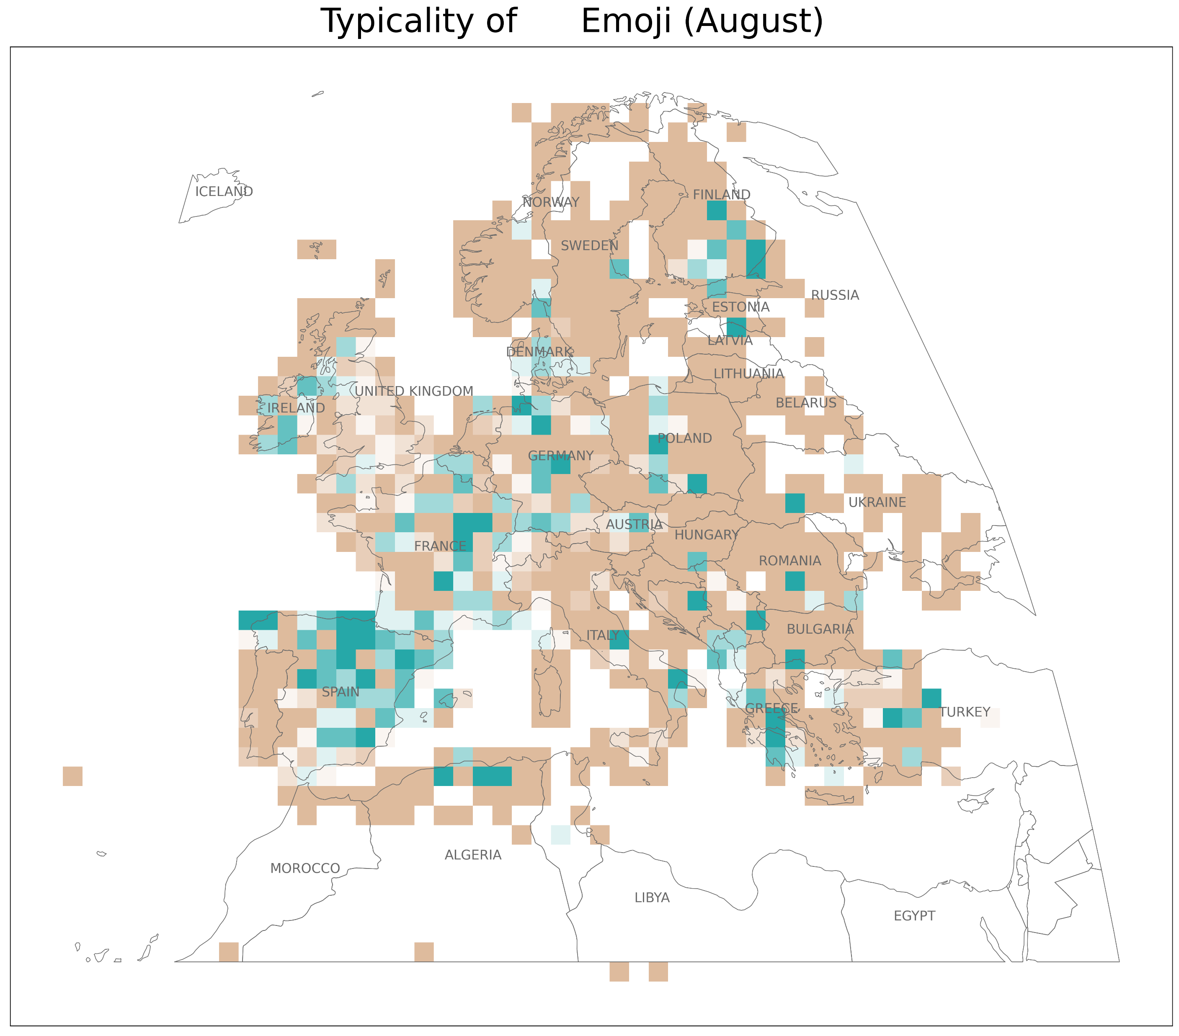
<
>

Slide 9

<
>

Slide 10
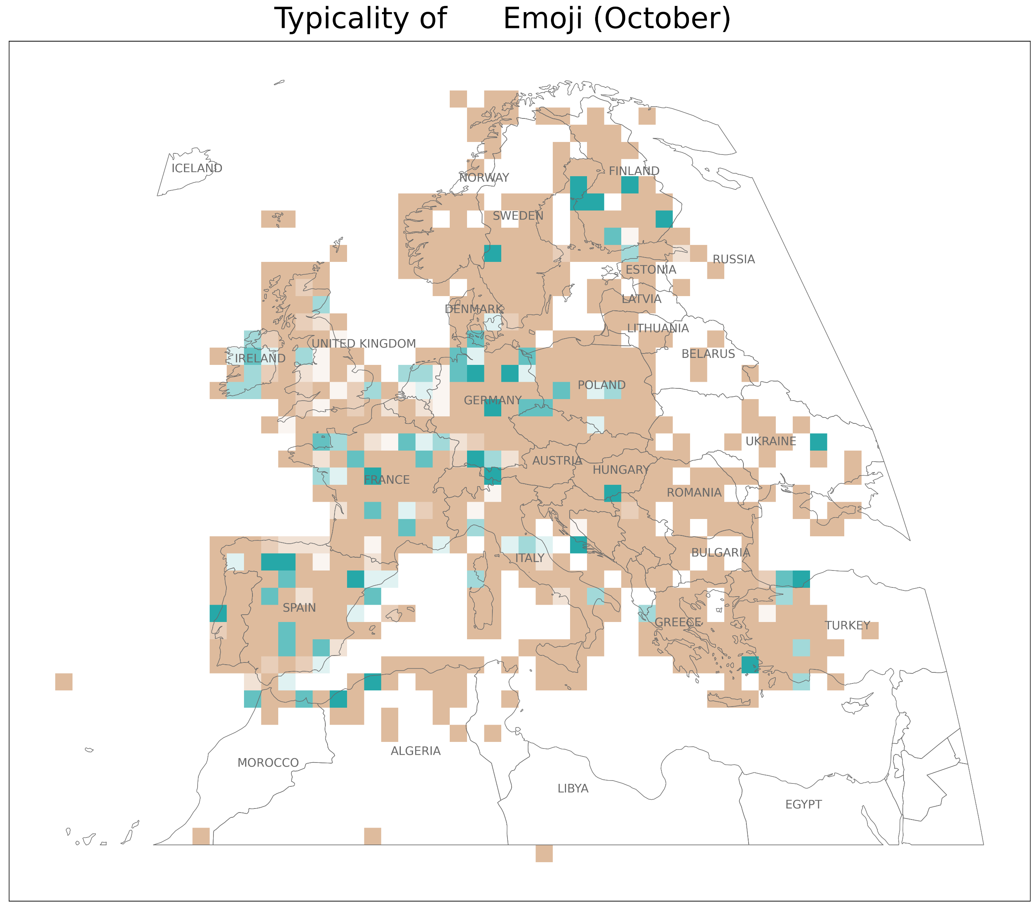
<
>

Slide 11




